Slide 1
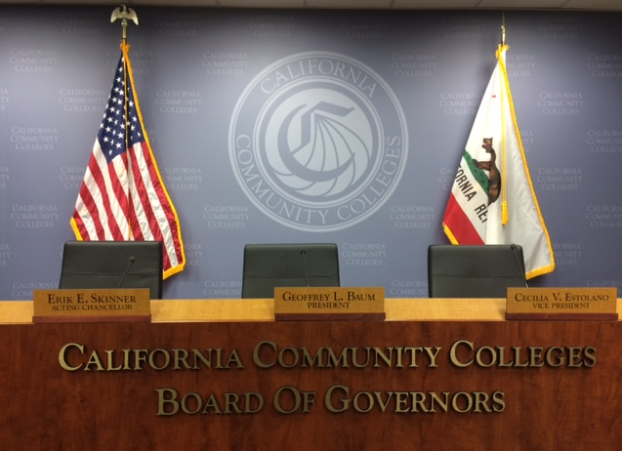
Community College Athlete Name, Image, and Likeness Working Group
Bagley-Keene Open Meeting Act Training
Fermin Villegas
Deputy Counsel
California Community Colleges
Chancellor’s Office

Slide 2
POLICY
“It is the public policy of this state that public agencies exist to aid in the conduct of the people’s business and the proceedings of public agencies be conducted openly so that the public may remain informed.”
- Gov. Code section 11120

Slide 3
STATE BODIES
“All meetings of a state body shall be open and public and all persons shall be permitted to attend any meeting of a state body except as otherwise provided in this article.”
-Gov. Code section 11123(a)

Slide 4
Is this a “State Body?”
“State Bodies” include:
  Multi-member bodies
  Advisory bodies
  Delegated bodies
“Multi-member bodies”
  Two-part test:
    1) The body is created by statute or required by law to conduct official meetings; and
    2) The body consists of two or more members.
CC Athlete Name, Image, and Likeness Working Group
  Created by statute: Ed. Code § 67457 (SB 206)
  Consists of a minimum of 9 members: Ed. Code § 67457(a)(1)

Slide 5
Is this a “Meeting?”
“Any congregation of a majority of the members of a state body at the same time and place to hear, discuss, or deliberate upon any item that is within the subject matter jurisdiction of the state body to which it pertains.” (Gov. Code § 11122.5(a))
Bagley-Keene is not limited to “meetings” where a final decision is made!
    “HEAR”
    “DISCUSS”
    “DELIBERATE”

Slide 6
Serial Meetings
“Any use of direct communication, personal intermediaries, or technological devices that is employed by a majority of the members of the state body to develop a collective concurrence as to action to be taken on an item by the members of the state body is prohibited.” (Gov. Code § 11122.5(b))
Common Types of Serial Meetings:
  Daisy Chain
  Hub and Spoke
  Email

Slide 7
Meetings – Exceptions to the Rule
Individual Contacts
  But beware the serial meeting!
Social or Ceremonial Occasions
  So long as business of the state body is not discussed
Conferences and Retreats
  So long as open to the public and involve subject matter of general interest to the public
Meetings of Another Legislative Body
  Meeting must be open to the public and properly noticed

Slide 8
Public Notice
Notice of Meeting
  Posted online and at meeting location at least 10 days in advance
    N.B. only 3 Days under the Brown Act (local bodies)
  Must be provided to individuals who request notice in writing
  Must include date, time, and location of meeting and name, address, and telephone number of contact person for more information
Agenda
  Items to be discussed at the meeting
  Each item must be sufficiently described to allow public to determine whether to attend the meeting – a brief description sufficient
  Closed session items must reference specific statutory authority
Notice, agenda, and supporting documents are public records and must be made available to the public
No fees allowed

Slide 9
Authorized Closed Session Topics
The Bagley-Keene Act authorizes closed sessions for specific topics, including:
  Existing or anticipated litigation
  Real property negotiations
  Public employee appointments, evaluation and discipline
  Labor negotiations
  Threats to security
No exemption for embarrassing, difficult, sensitive, uncomfortable, or controversial topics

Slide 10
The Public’s Right to Attend
Public access required at all locations
Opportunity to address the body on each agenda item or any matter within the subject matter jurisdiction of body
Any person may record the proceedings via audio recorder, video recorder or still motion camera
No conditions may be set for attendance at or participation in a public meeting
  Sign-in/Self-identification not required
  Cannot prohibit criticism of state body
  But: May limit time per speaker if necessary
All meetings must comply with the ADA

Slide 11
Special & Emergency Meetings
48 hours notice
Limited purposes
Finding required on 2/3 Vote:
  10-day notice would impose a substantial hardship on the state body, or
  where immediate action is required to protect the public interest

Slide 12
Voting
Any votes must be recorded to show the vote count.
The body may also vote by roll call vote.

Slide 13
COVID-19 Pandemic Exceptions
Governor’s Executive Orders (N-29-20)
  No requirement of a meeting site with access
  Video or teleconference without public attendance
  Public comment opportunity required
  Public notice must indicate special procedures for virtual attendance and how to comment
  ADA Accessibility must be provided through closed captioning on request
  Roll call votes required

Slide 14
In summary…
Simple general rule:
  Conduct the public’s business in public…
  After giving the public notice and an opportunity to participate.

