Slide 1

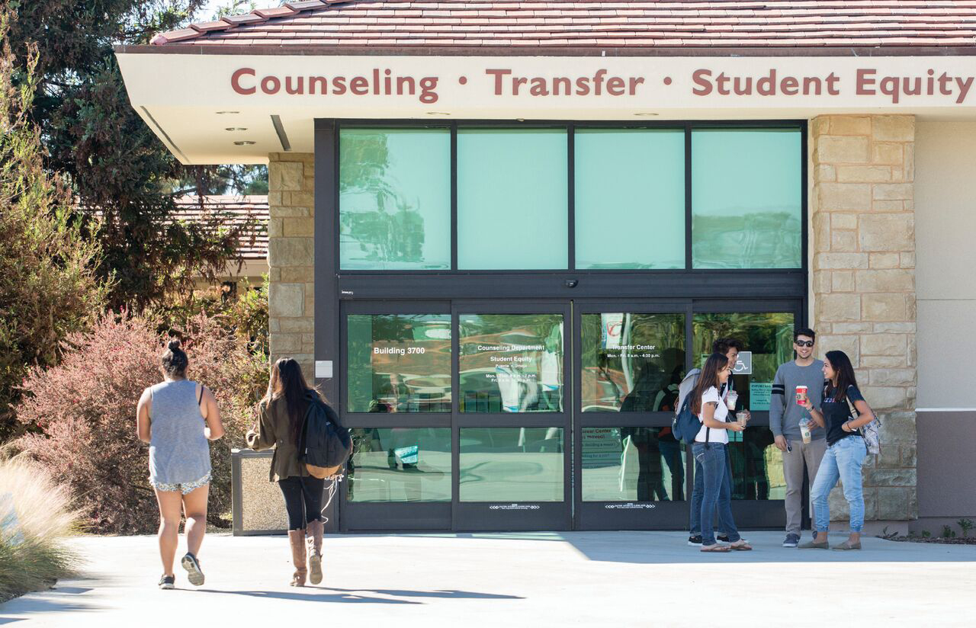
How to Use/Utilize
Perkins V Core Indicator Reports to Support Program Improvement and Student Outcomes
Office of Equitable Student Learning, Experience, and Impact
Workforce and Economic Development Division
October 2022
1

Slide 2
Introducing the Chancellor's Office Perkins Team
LaCandice Ochoa, Dean
Jean Claude Mbomeda, Program Specialist
Lupe Maldonado, Program Manager
Regina Malcolm, Program Analyst

Slide 3

Today's Agenda
Overview of Perkins V Act
Chancellor's Office Core Commitments
Overview of Perkins Core Indicators
Components of Improvement Plans
Open Forum for Q&A
3

Slide 4
Overview of Perkins V Act
The Strengthening Career and Technical Education for the 21st Century Act (Perkins V) was signed into law on July 31, 2018.
Provides annual Federal funding to support CTE for our youth and adults.
Perkins V funding allocated to the Chancellor’s Office is focused on preparing individuals from traditionally underrepresented student groups for high skill, high wage, and/or in-demand occupations.

Slide 5
Special Population Student Groups Outlined in Perkins V
Individuals with disabilities
Individuals from economically disadvantaged families, including low-income youth and adults
Individuals preparing for nontraditional fields
Single parents, including single pregnant women
Individuals out of the workforce
English language learners
Individuals who are homeless*
Youth who are in or have aged out of the foster care system*
Youth with parents who are active military*
*Newly added groups in Perkins V

Slide 6

Chancellor's Office Commitment to Serving Students from Underrepresented Groups
The Vision for Success has been and continues to be our North Star.
Over 69% of California community colleges students are people of diverse ethnic backgrounds.
47% of students do not pay fees.

Slide 7

Vision Goals
Vision Commitments
Reduce and erase equity gaps
Focus on students’ goals
Design with the students’
experience in mind
High expectations and high support
Foster use of data and evidence
Own student performance
Thoughtful innovation and action
Cross-system partnership
Reduce regional gaps
Decrease average unit obtainment for a degree to 79
Increase credential obtainment by 20%
  Increase transfer by 35% to UC and CSU
Increase employment for CTE students to 76% in their field of study

Slide 8

Chancellor's Office Core Commitments to Student-Centered Design, Use of Data, and Innovation
Focus relentlessly on students’ end goals.
Always design and decide with the student in mind.
Foster the use of data, inquiry, and evidence.
Enable action and thoughtful innovation.
8

Slide 9
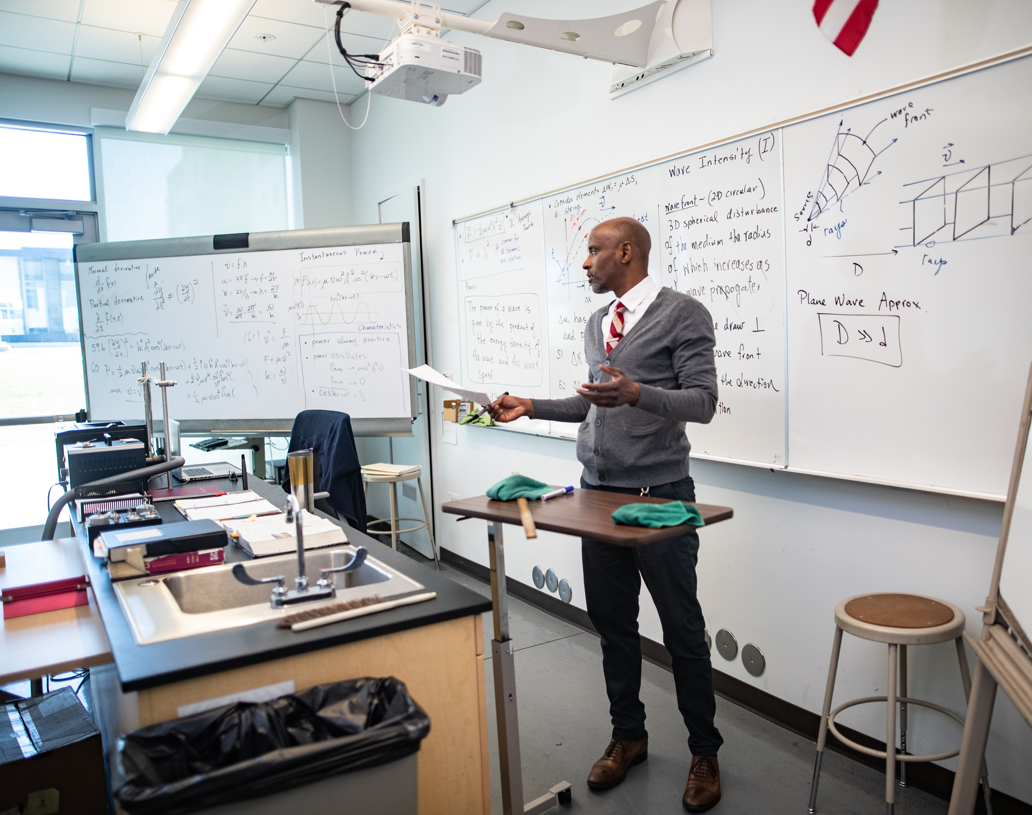
Overview of Perkins Core Indicators and Improvement Plans
Jean Claude Mbomeda, Specialist

Slide 10
Perkins Core Indicators of Performance
Perkins IV | Perkins V
1P1: Technical Skill Attainment 2P1: Credential, Certificate or Diploma 3P1: Student Retention or Transfer 4P1: Student Placement 5P1: Nontraditional Participation 5P2: Nontraditional Completion | 1P1: Postsecondary Placement 2P1: Earned Recognized Postsecondary Credential 3P1: Non-traditional Program Concentration

Slide 11
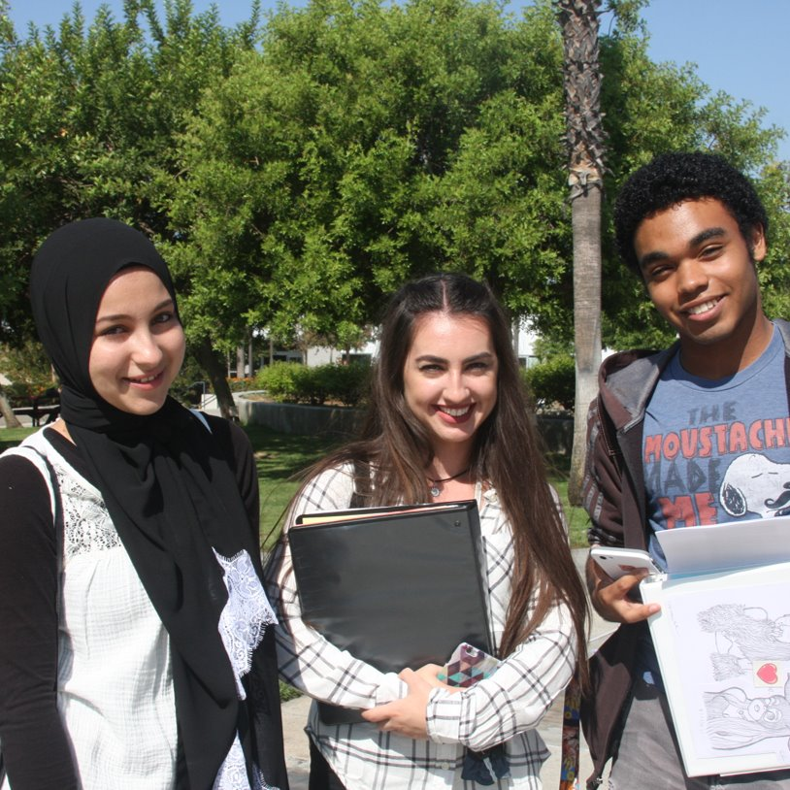
Core Indicator #1: Postsecondary Retention & Placement
% of CTE concentrators who during the second quarter after program completion:
Remain enrolled in postsecondary education;
Are in advanced training; OR
Who are placed or retained in employment

Slide 12

Core Indicator #2: Earned Postsecondary Credential
% of CTE concentrators who receive a recognized postsecondary credential during participation in or within 1 year of program completion
Credential includes Certification, degree, certificate, license.

Slide 13
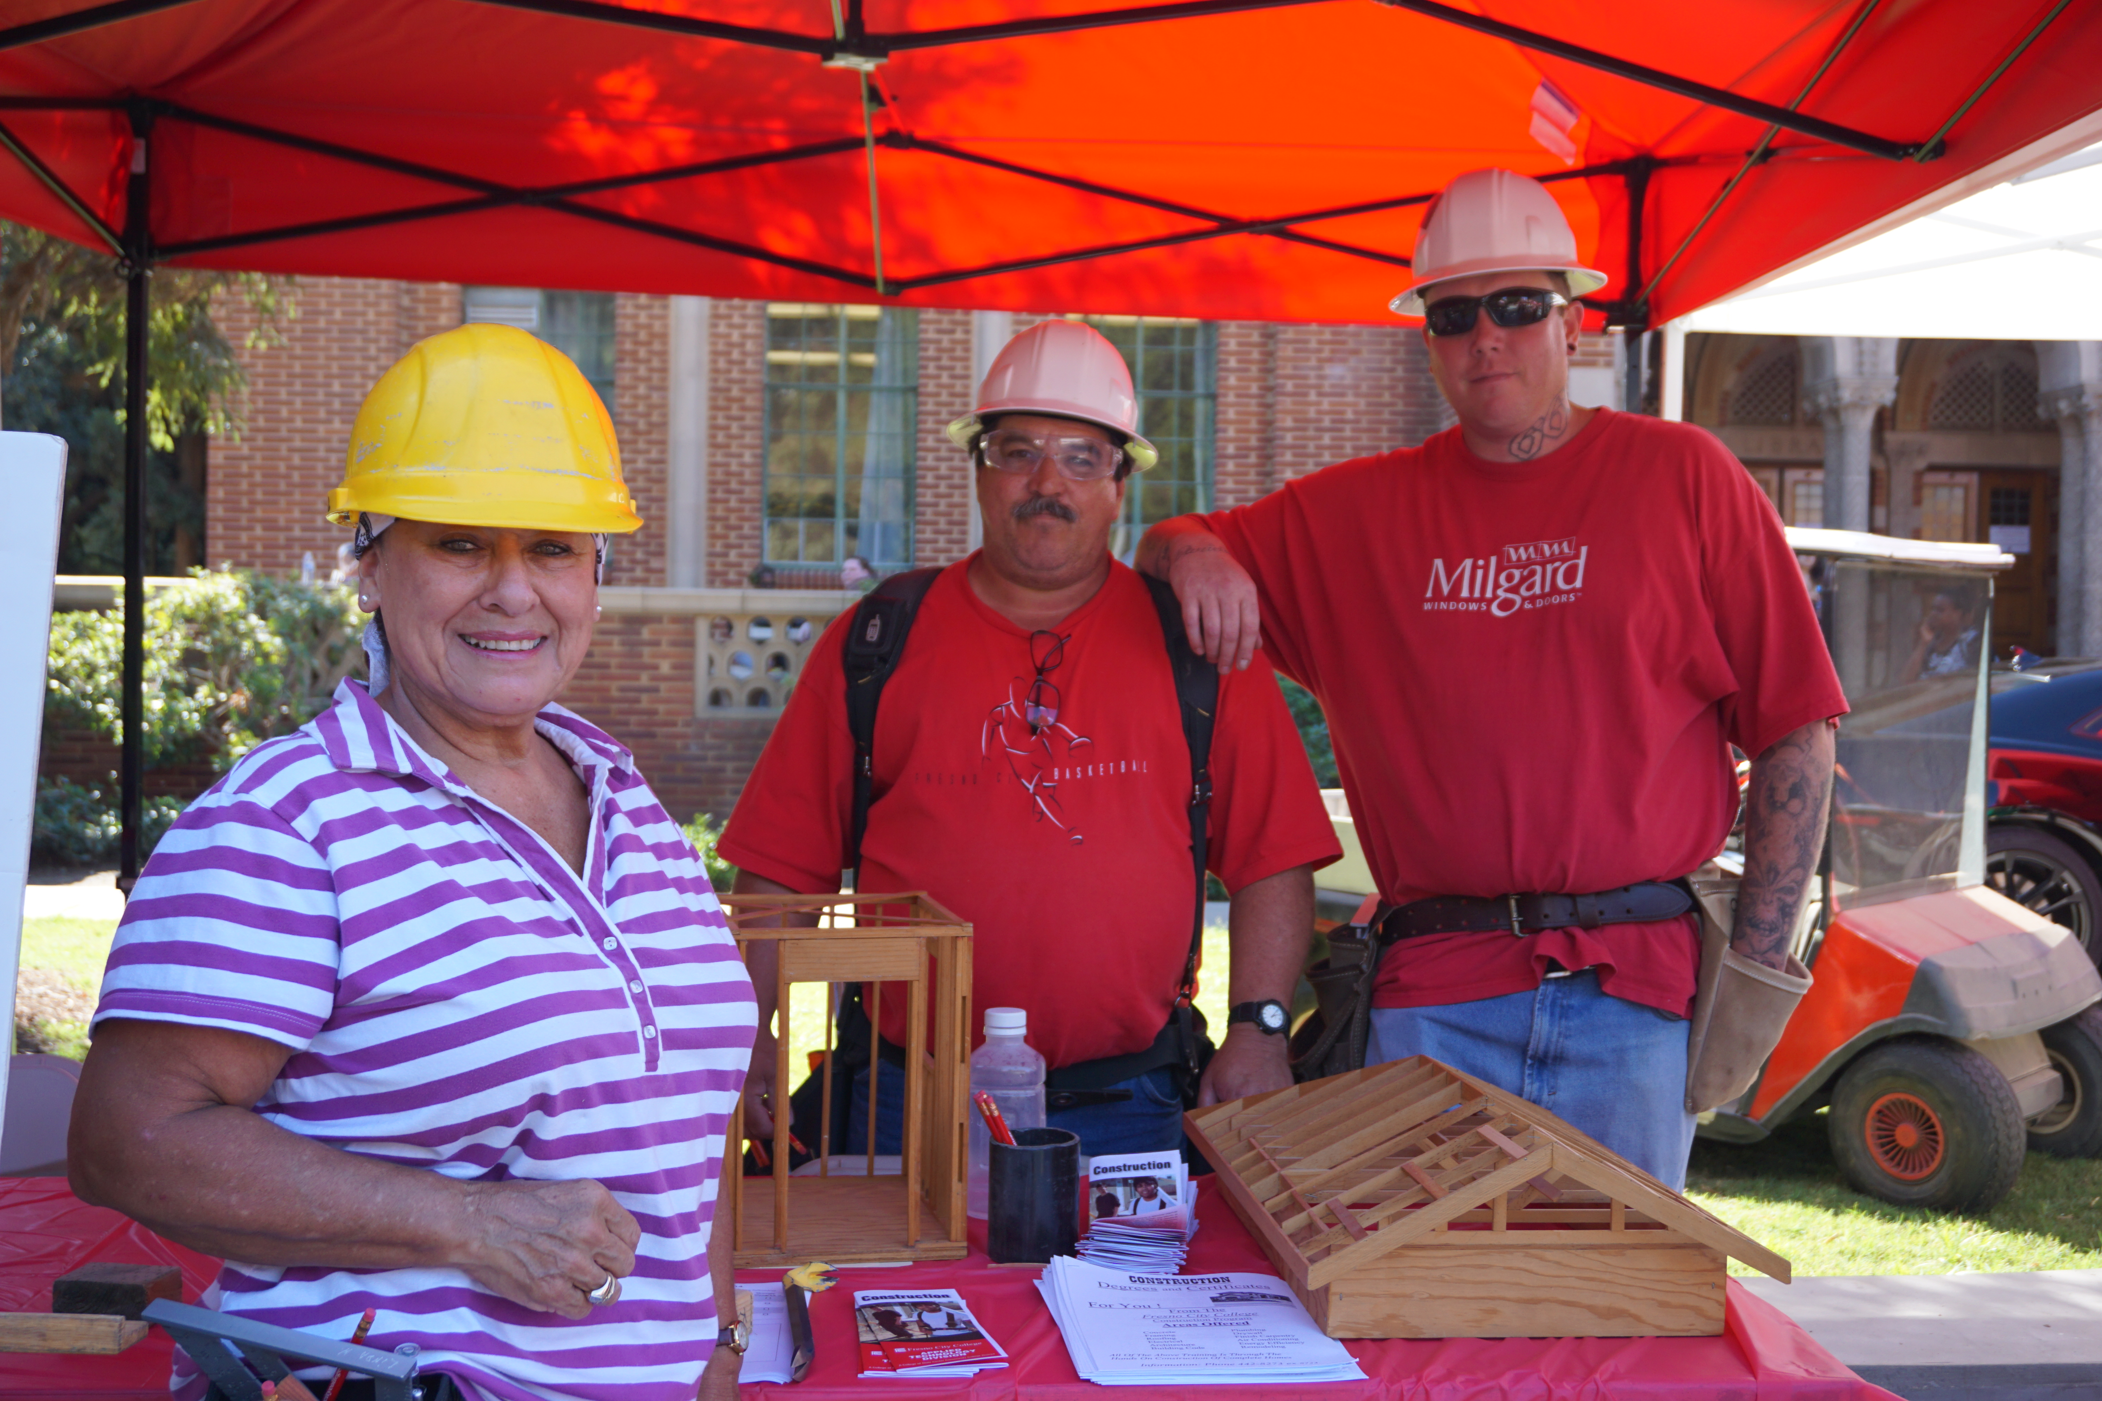
Core Indicator #3: Non-traditional Fields
% of CTE concentrators in CTE programs and programs of study that lead to non-traditional fields
This means that a student gets counted under this indicator if individuals from their gender comprise less than 25 percent of the individuals employed in the related occupation or field of work.

Slide 14
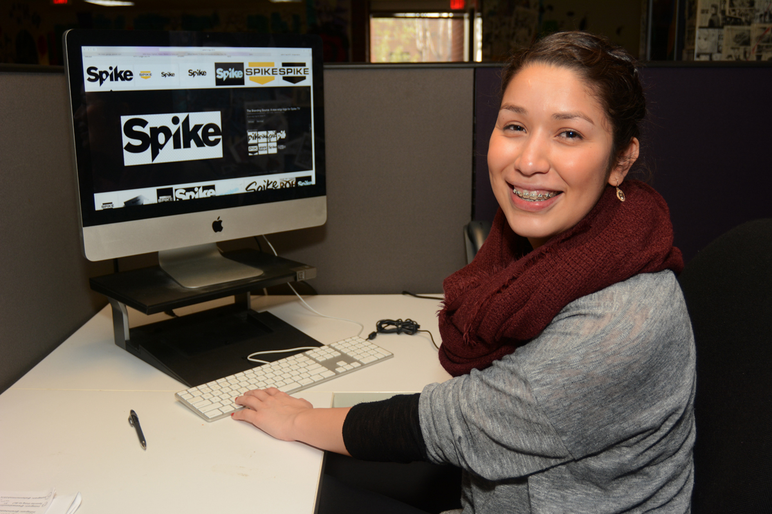
Core Indicator #4: Employment
CTE student transitions to employment, apprenticeships, or the military

Slide 15
FY 2022-23 Perkins Core Indicators of Performance
Core Indicators | State Targets | Threshold
1P1: Postsecondary Placement | 91.75 | 82.575
2P1: Earned Recognized Postsecondary Credential | 89 | 80.1
3P1: Non-traditional Program Concentration | 26 | 23.4

Slide 16
Improvement Plans
Any core indicator below
90 % of the State determined performances levels MUST write an improvement Plan.
Components of an Improvement Plan
Identification of the student groups where gaps in performance exist
Contextual factors contributing to existing performance gaps
Resources needed
Timeline
Person(s) responsible
Description of how progress will be documented

Slide 17
Shifting from Compliance to Student Outcomes
A requirement of receiving Perkins V funding is that colleges must report data to provide evidence of meeting the “Core Indicators of Performance for CTE Concentrators" as outlined in Perkins legislation.
Reporting of data (compliance) isn't enough BECAUSE.....
We continue to see disproportionate below state and district determined levels for the following student groups:
  Individuals out of the workforce;
  English language learners; and
  Individuals with disabilities.

Slide 18
Resources to Support Improvement Plans
LaunchBoard: https://www.calpassplus.org/LaunchBoard/Home.aspx
Core Indicator Reports in the MIS System: https://misweb.cccco.edu/perkinsv/Core_Indicator_Reports/Forms_All.aspx
Comprehensive Local Needs Assessment (CLNA)
Chancellor's Office Perkins Team: https://www.cccco.edu/About-Us/Chancellors-Office/Divisions/Workforce-and-Economic-Development/Career-Education-Practices/Perkins-V

Slide 19

Open Forum for
Questions and Answers
What challenges are colleges or districts experiencing with addressing core indicator performance gaps?
How can the Chancellor's Office support improvement efforts to be focused on student outcomes?
19

Slide 20


Thank you!
Please contact us for ongoing support:
perkinssupport@cccco.edu.
www.cccco.edu
20

