Slide 1


A Practical Approach to Perkins Plan Development
& Implementation
Ioanna Iatridis, Dean, Perkins & SWP Programs
Jean Claude Mbomeda – Program Specialist, WEDD
Lupe Maldonado – Program Monitor
Kyn Hoang – Program Analyst

Slide 2



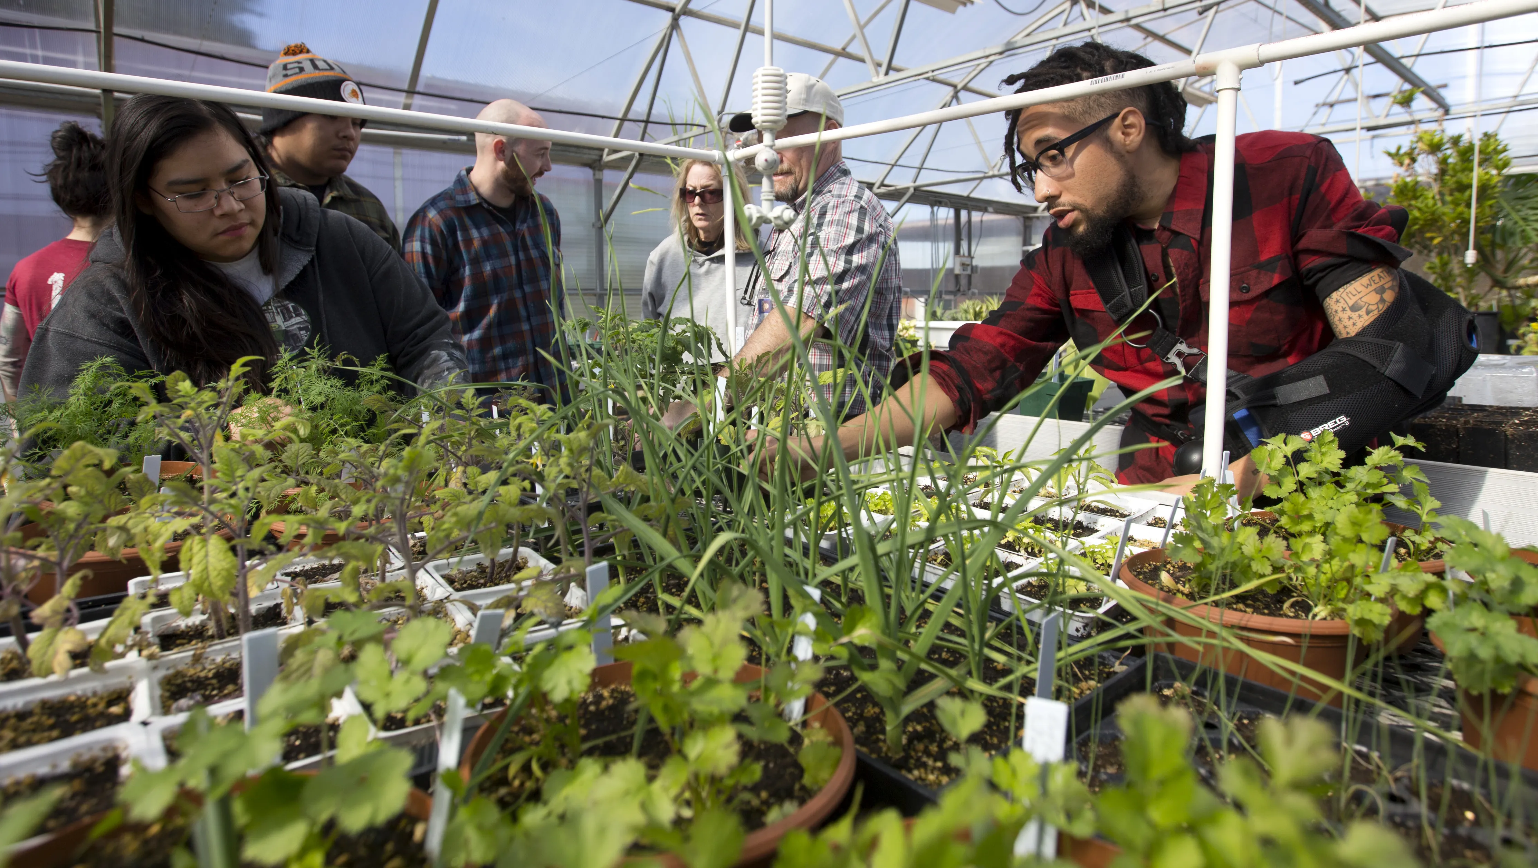
Perkins Background
Originally passed as the Vocational Education Act of 1963
Renamed the Carl D. Perkins Act in 1984
  It was enacted to increase learner access to high-quality CTE programs of study, especially to those students who had been underserved in the past or who had substantial education needs.
  The goal was to provide individuals with the academic and technical knowledge and skills they need to prepare for careers in current or emerging employment sectors.
  It is a principal source of federal funding to states and discretionary grantees for the improvement of secondary and postsecondary career and technical education programs across the nation.
The Strengthening Career and Technical Education for the 21st Century Act (Perkins V) was signed into law on July 31, 2018.

Slide 3
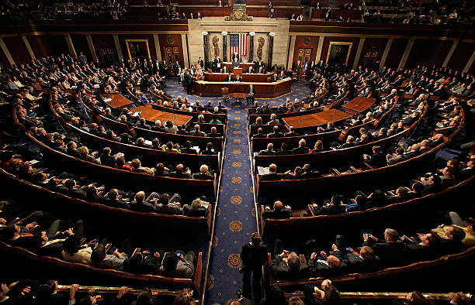

Perkins Distribution
Each year under the Perkins statute, Congress appropriates approximately $1.2 billion dollars in State formula grant funds under Title I (Basic State Grants) to develop more fully the academic knowledge and technical and employability skills of secondary and postsecondary education students who elect to enroll in career and technical education programs and programs of study.
  The Basic State Grants Program (Title I) are allotted to states through a formula based on populations in certain age groups and earning certain levels of per-capita income
  Allocation comes to CDE and CDE disburses the Community College’s share to the Chancellor’s Office
    $139M to California
CALIFORNIA

Slide 4

Perkins Distribution at Post-Secondary Level
CDE disperses the Perkins funds in a CDE and Chancellor’s Office split (Example: FY 2021-2022 CDE 47.69%, CO 52.31%)
The CO then allocates the funding to:
  The Community Colleges by Headcount - $51M
  The 8 Regional Consortia (RC) - $2.5M
  State Leadership Support $691K
  State Contracts $169K
  Perkins Support at the Chancellor’s Office

Slide 5
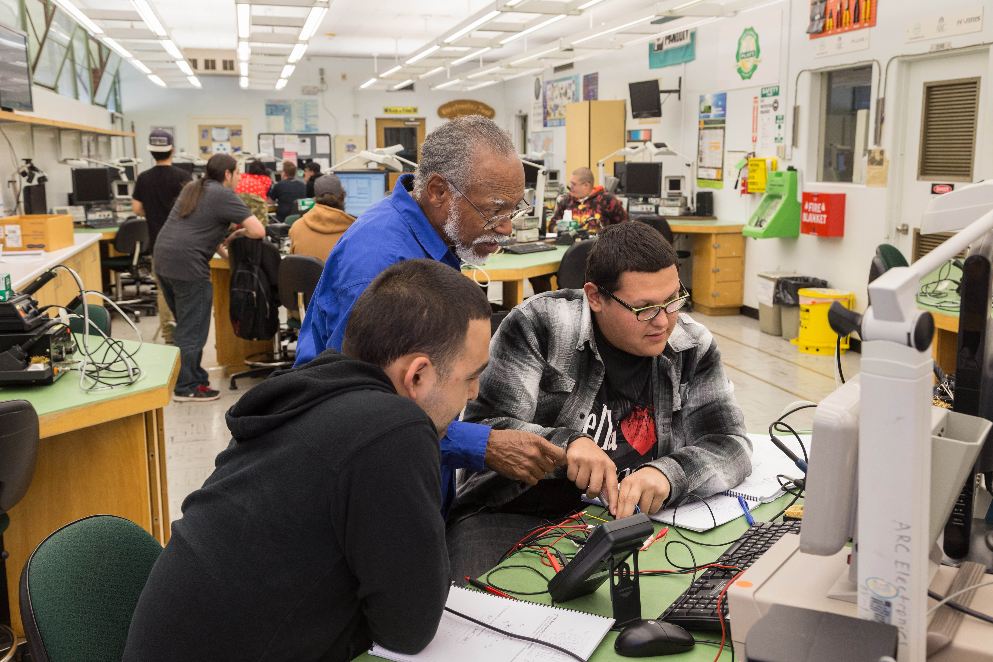
The 2022-2023 Perkins V Application

Slide 6

Key Dates and Reporting
Opening Application Date: March 16, 2022
Closing Application Date: May 17, 2022
Starting Activity Date: July 1, 2022
Application Component
  Comprehensive Local Needs Assessment
  Allocations
  Reporting System (NOVA)

Slide 7
The Comprehensive Local Needs Assessment (CLNA)
Is a significant component of Perkins V and must be completed and included as an attachment with the Local Application in NOVA
  The goal of a needs assessment is to help educators identify, understand, and prioritize the needs that districts and schools must address to improve performance
  Requires data driven decision making on Local spending
Involves a wide group of stakeholders reviewing a number of elements, including student performance data, program quality, labor market needs, educator development and special populations’ access to programs.

Slide 8
Elements that must be addressed in the CLNA
Student performance on federal accountability indicators, disaggregated
How programs are aligned to labor market needs
Whether programs are of sufficient size, scope and quality to meet all students’ needs
Progress toward implementing programs and programs of study
Efforts to improve recruitment, retention and training of faculty
and staff
Progress toward improving access
and equity

Slide 9

Relationship Between the CLNA & the Application
Needs Assessment
Identify areas of strength in CTE system / programs:
  Using prior year enrollment data as a baseline to measure successful district’s benchmarks completed.
Identify areas of weakness and gaps in CTE system / programs:
  Using prior year data as a baseline to measure lack of targets completed of core indicators.
Informed/validated by stakeholders and partners
  Collaborate with stakeholders to analyze strengths and weaknesses in CTE system and programs
  Assess data gathering methods
Local Application
Lay out eligible recipient’s vision or theory of action for CTE
  Develop a detailed workplan, budget, and governance model that demonstrates how goals and objectives will lead to intended outcomes.
Identify strategies, solutions and investments to sustain and scale strengths in CTE system / programs:
  Develop an infrastructure that builds upon current plan
Identify strategies, solutions and investments to address weakness and gaps in CTE system /programs
  Using analysis on failed targets, develop infrastructure that includes investment that focuses on weak areas.

Slide 10
CLNA Links:
CLNA Webinar (Video)
CLNA Presentation (PDF)
2022-2023 Comprehensive Local Needs Assessment (CLNA) Framework (PDF)

Slide 11
2022-2023 District Allocation (Headcount)
Certification Memo
  Report 1: CTE Unduplicated Headcount
  Report 2: CTE Duplicate Headcount

Slide 12
Perkins V Core Indicators
Perkins V Core Indicators of Performance | State Vision for Success Metrics
1 P1: Postsecondary Placement and Retention Target : 91.75% | Goal: Over five years, increase by 35% the number of CCC students transferring annually to a UC or CSU. Over five years, increase the percent of exiting FTE students who report being employed in their field of study,
2P1: Earned Recognized Postsecondary Credentials Target : 89 % | Goal: Over five years, increase by at least 20% the number of CCC students annually who acquire associate degrees, credentials, certificates, or specific skill sets that prepare them for an in-demand job.
3P1: Non-Traditional Program Concentration Target: 26% | Goal: Reduce equity gaps across all of the above measures
Notes:
In 2019-20, there were 1,297,803 participants in career and technical education (CTE) in California. Of the students reporting as male or female, 53.6 percent of secondary CTE participants were male, and 46.4 percent were female. At the postsecondary level, 50.6 percent of CTE participants were male and 49.4 percent were female.

Slide 13
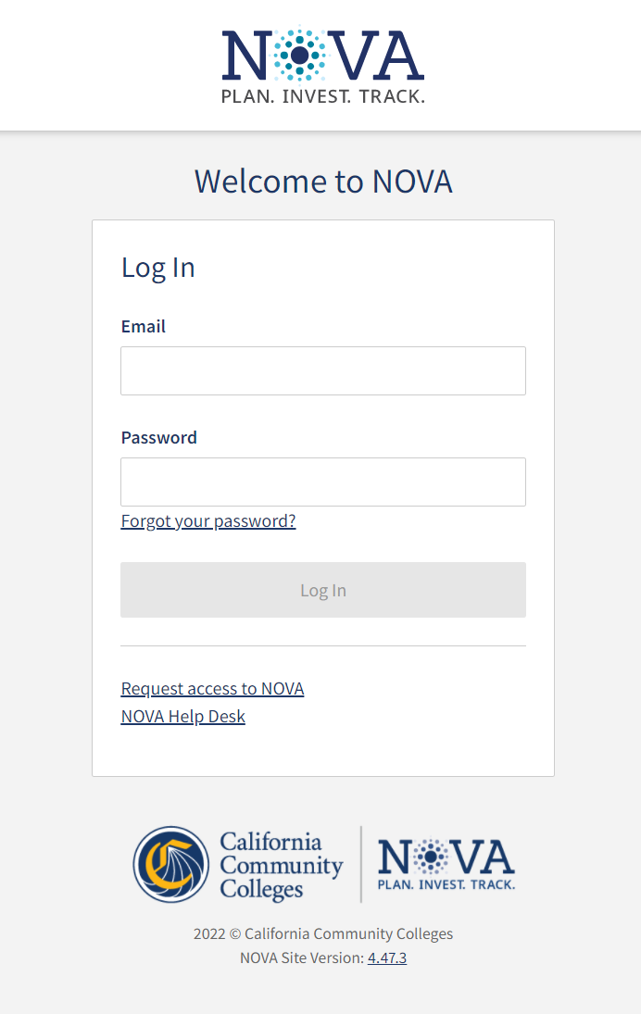
Perkins 1C Application Guide
Login to NOVA at nova.cccco.edu
  If you do not have an account please request access to NOVA here
For help with NOVA please contact NOVA Support
For Perkins V support please contact perskinssupport@cccco.edu

Slide 14
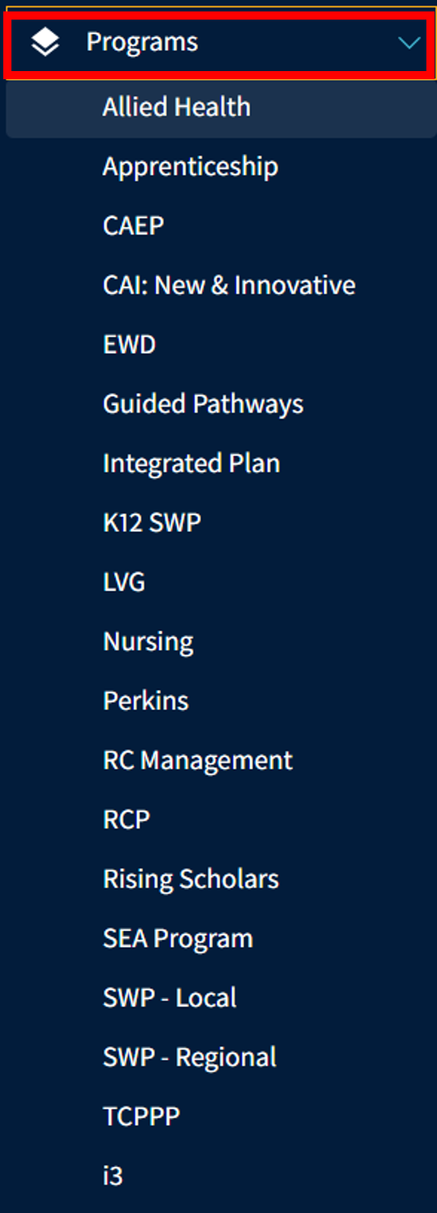
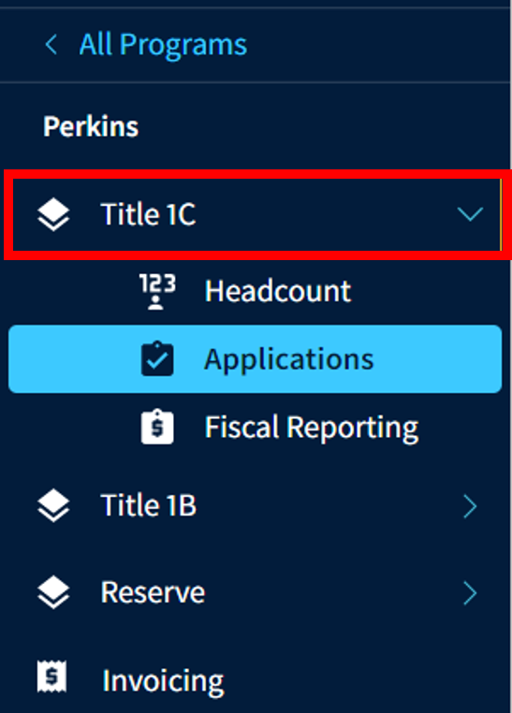
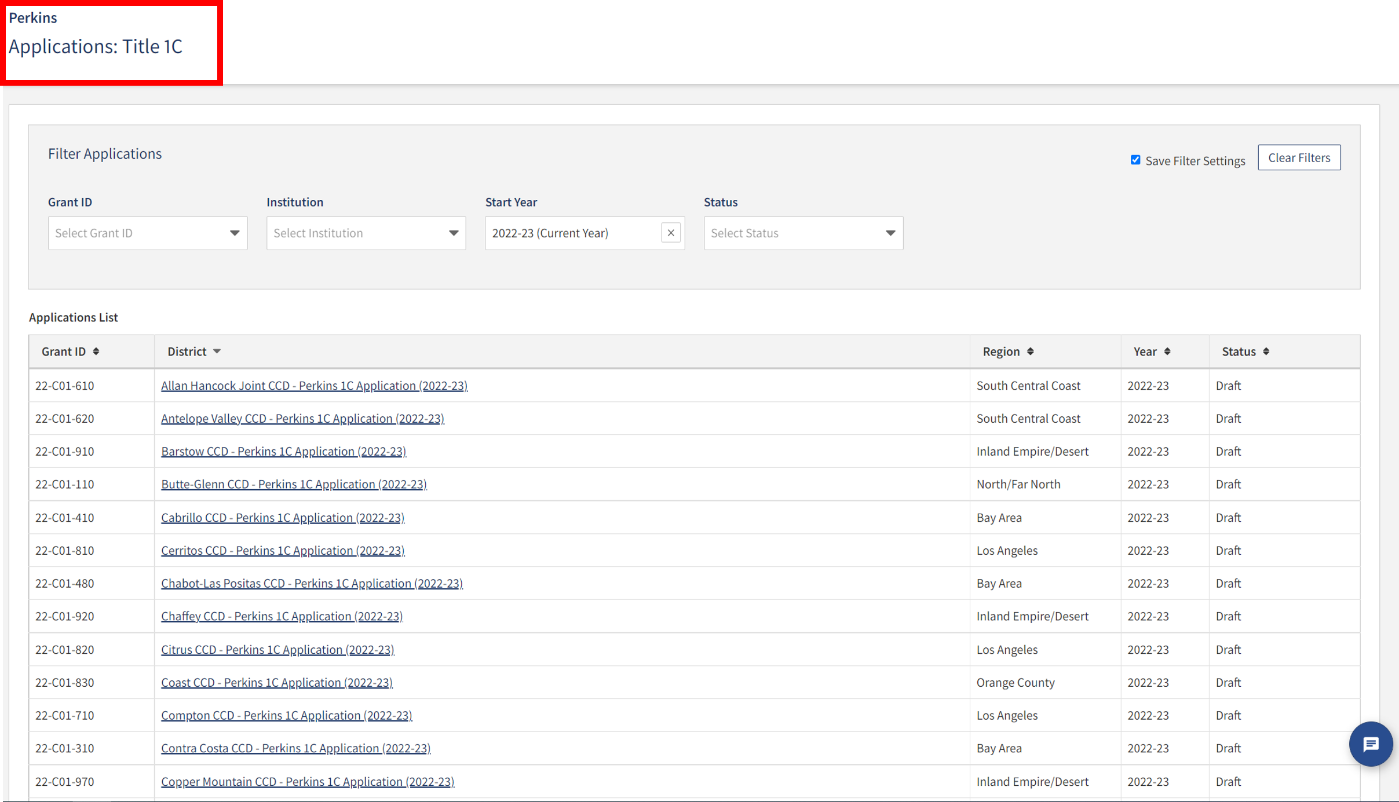
NOVA Login
1.
5.
3.
4.
2.

Slide 15
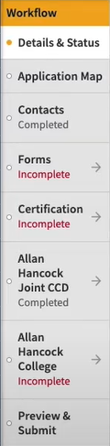
Perkins 1C Application Sections
Details & Status:
  District details
  Allocation Amount
Application Map:
  Overview of Application sections and status of completion
Contacts
Forms:
  Responses to the Local Plan requirements
Certification
Notes:
Elaborate on Contacts and Certification in speaking notes.

Slide 16
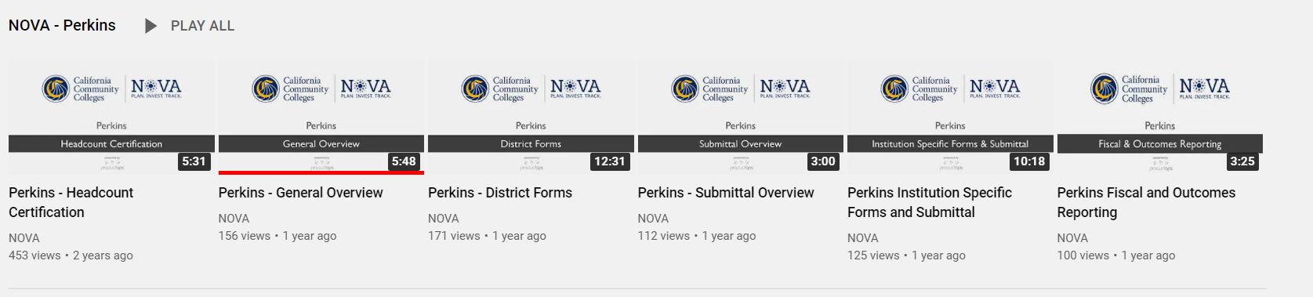
Perkins Training Videos
Perkins Training Videos

Slide 17
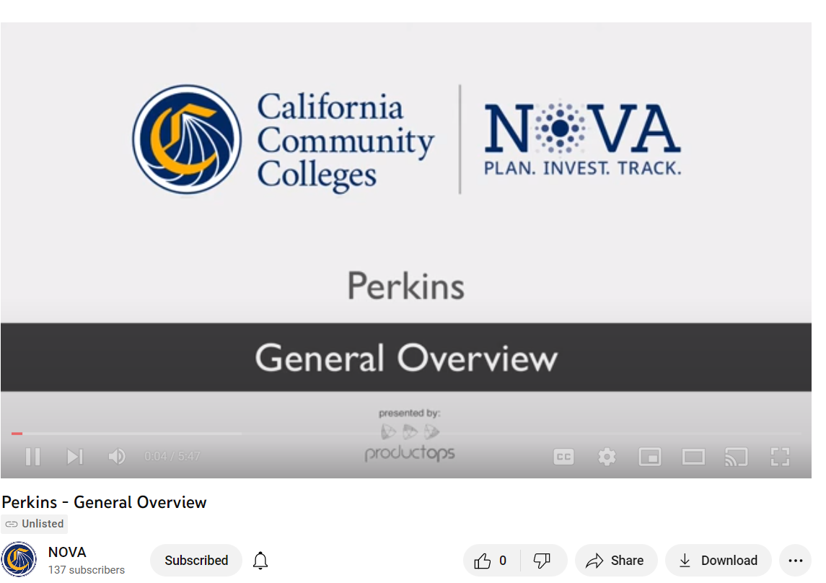
Perkins 1C General Overview Video
Watch Video at https://youtu.be/SxhVJ-BWrGE

Slide 18

Sharing of Best Practices
Harriet Happel
Dean, Career Education and Integrative Learning
College of the Canyons

Slide 19
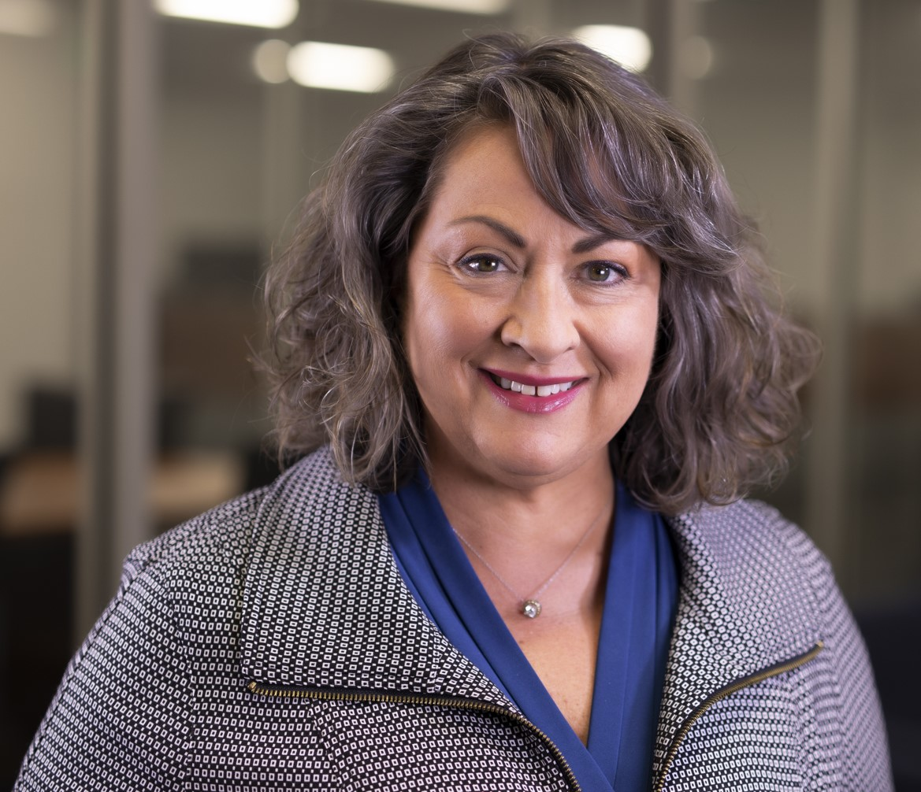
Harriet Happel
Harriet Happel serves in the role of Dean of Career Education, Integrative Learning and the Employment Center at College of the Canyons in Santa Clarita, California. She also serves on the executive board for the California Community College Association of Occupational Education as the Communications Officer. Prior to coming to College of the Canyons, Harriet served as the Director of Perkins Grant Operations and Career Technical Education Coordinator at Elgin Community College in Elgin, Illinois. She is also an instructor in the disciplines of Advanced Manufacturing, Business, and Career Skills.
Ms. Happel is a California Community College student who transferred to the University of California at San Diego where she completed her undergraduate work in Political Science. Harriet worked as a Project Manager and Managing Business Partner at Management Resource Group, a San Diego based business consulting firm specializing in performance management for non-profit organizations. After moving to the mid-west, she worked with Camcraft, Inc., a manufacturer of high precision component parts for the automotive industry, as the Program Manager for New Product Introduction. While in the mid-west she completed her Master of Business Administration degree at Keller Graduate School of Management with specializations in Project Management and Sustainability. Harriet also holds a certification from the University of Vermont in Campus Sustainability Leadership and is a certified instructor in Phi Theta Kappa’s Leadership Development Studies Program and the International Public Safety Leadership and Ethics Institute Leadership Development Program.
When not working, Harriet enjoys gardening and spending time traveling with her family.

Slide 20
Section 1 Requirements I
SECTION ONE: REQUIREMENTS FOR USES OF FUNDS- Provide your summary of requests in this section and be sure to address all the Continuous Improvement Goals that are relevant.
# | Continuous Program Improvement Goals | Activities that Meet Requirements | Continuous Program Improvement Goals: SMART Specific: Target a specific area for improvement Measurable: Quantify. List an indicator(s) of progress. Agreed Upon: Specify who will do it. Realistic: Is this scalable given available resources? Time-related: What results can be achieved in FY23?
1 | Strengthen the academic, and career and technical skill of students participating in CTE programs through the integration of academics with CTE programs. | - | -
2 | Link CTE at the secondary and the postsecondary levels. | - | -
3 | Provide students with strong experience in and understanding of all aspects of an industry, which may include work-based learning experiences. | - | -
20

Slide 21
Section 1 Requirements II
# | Continuous Program Improvement Goals | Activities that Meet Requirements | Continuous Program Improvement Goals: SMART Specific: Target a specific area for improvement Measurable: Quantify. List an indicator(s) of progress. Agreed Upon: Specify who will do it. Realistic: Is this scalable given available resources? Time-related: What results can be achieved in FY23?
4 | Develop, improve, or expand the use of technology in CTE, which may include training to use technology, providing students with the skills needed to enter technology fields, and encouraging schools to collaborate with technology industries to offer internships and mentoring programs. | - | -
5 | Provide in-service and pre-service professional development programs to faculty, administrators, and career guidance and academic counselors involved in integrated CTE programs, on topics including effective integration of academics and CTE, effective teaching skills based on research, effective practices to improve parental and community involvement, effective use of scientifically based research and data to improve instruction. Professional development should also ensure that faculty and personnel stay current with all aspects of an industry, involve internship programs that provide relevant business experience; and train faculty in the effective use and application of technology. | - | -

Slide 22
Section 1 Requirements III
# | Continuous Program Improvement Goals | Activities that Meet Requirements | Continuous Program Improvement Goals: SMART Specific: Target a specific area for improvement Measurable: Quantify. List an indicator(s) of progress. Agreed Upon: Specify who will do it. Realistic: Is this scalable given available resources? Time-related: What results can be achieved in FY23?
6 | Develop and implement evaluations of the CTE programs carried out with Perkins V funds, including an assessment of how the needs of special populations are being met. | - | -
7 | Initiate, improve, expand and modernize quality CTE programs, including relevant technology. | - | -
8 | Provide services and activities that are of sufficient size, scope and quality to be effective. | - | -
9 | Provide activities to prepare special populations including economically disadvantaged students enrolled in CTE programs, for high-skill, high-wage, or high-demand occupations that will lead to self-sufficiency. | - | -

Slide 23
Section 2 Goals I
SECTION TWO: PROGRAM IMPROVEMENT GOALS: Provide a ranking of the activity requests/goals made in Section One in this section and be sure to address the relevant core indicator and Vision for Success Goals with measurable outcomes. What is the cost and what type of resources will be required.
Rank | Activity Goals | Which Core Indicator (s) and Vision for Success Goals will this activity improve? | Measureable Outcomes | Cost ($) | Required Resources (Human and Physical)
1 | - | - | - | - | -
2 | - | - | - | - | -
3 | - | - | - | - | -
4 | - | - | - | - | -
5 | - | - | - | - | -
23

Slide 24
Section 3 Employer Engagement
SECTION THREE: EMPLOYER ENGAGEMENT. Using the ranking for funded activity goals as listed in Section Two, please address how the activity goal(s) will improve Employer Engagement.
Rank | Activity Goals | Which Employer Engagement Goals will this activity improve?
1 | - | -
2 | - | -
3 | - | -
4 | - | -
5 | - | -
24

Slide 25
Goals and Activities Perkins V Core Indicators
Perkins V Core Indicators:
1P1: Postsecondary Retention and Placement
The percentage of CTE concentrators who, during the second quarter after program completion, remain enrolled in postsecondary education, are in advanced training, military service, or a service program that receives assistance under title I of the National and Community Service Act of 1990(42 U.S.C. 12511 et., seq) are volunteers as described in section 5(a) of the Peace Corps act (22 U.S.C. 2504(a)), or are placed or retained in employment.
2P1: Earned Recognized Postsecondary Credential
The percentage of CTE concentrators who receive a recognized postsecondary credential during participation in or within 1 year of program completion.
3P1: Non-Traditional Program Enrollment
The percentage of CTE concentrators in career and technical education programs and programs of study that lead to non-traditional fields.
25

Slide 26
Goals and Activities CCCCO Vision for Success Goals
California Community Colleges Chancellor's Office Vision for Success Goals:
INCREASE DEGREE & CERTIFICATE ATTAINMENT Through Guided Pathways, colleges provide students with program maps that help them get and stay on the path that’s as straightforward as possible and furthers their career goals.
INCREASE TRANSFERS TO FOUR-YEAR INSTITUTIONS Our student transfer rate continues to increase year over year. We’ve nearly doubled the number of students receiving associate degrees for transfer since 2015. Every year, our colleges introduce new degrees with a guarantee for transfer to the California State University system.
SECURE GAINFUL EMPLOYMENT We’re stepping up and playing a key role in connecting displaced workers who will be on the front lines of economic recovery efforts to career training opportunities. This means improving onramps to learning and off-ramps to work for learners of all ages.
REDUCE EXCESS UNIT ACCUMULATION BY STUDENTS By abandoning a placement system that failed to accurately measure students’ potential, particularly students of color, colleges more than doubled the number of transfer-level courses and significantly reduced or eliminated remedial courses that don’t count toward graduation.
CLOSE EQUITY GAPS We’re asking colleges to identify students most in need so that they can tailor their support. We provided more flexibility with funding for programs and services that advance equity.
CLOSE REGIONAL ACHIEVEMENT GAPS Nearly half of our students have tuition covered by the California College Promise grant. We’re working with the legislature to increase financial aid and its flexibility so that students can cover other important college expenses like rent, food, and books.
26

Slide 27
Goals and Activities SWP Employer Engagement Goals
SWP Employer Engagement Goals
The expansion of work-based learning for all students in the program of study
The increase of student employment outcomes
The responsiveness of activity goal to the training needs of employers
27

Slide 28
Example
# | Continuous Program Improvement Goals | Activities that Meet Requirements | Continuous Program Improvement Goals: SMART Specific: Target a specific area for improvement Measurable: Quantify. List an indicator(s) of progress. Agreed Upon: Specify who will do it. Realistic: Is this scalable given available resources? Time-related: What results can be achieved in FY23?
9 | Provide activities to prepare special populations including economically disadvantaged students enrolled in CTE programs, for high-skill, high-wage, or high-demand occupations that will lead to self-sufficiency. | 9.1 Developed and continue to adjust an 18 unit CAD Certificate to appeal to special population students (particularly working adults) looking for a quick completion option. This sequence of classes was converted in 2020-2021 to 100% online in order to increase access for working adults and special populations (ie students with disabilities) for CVC/OE[ grant. 9.2 Developed a 4.5 unit Sustainable Development Certificate of Specialization to appeal to working professionals and special populations looking for a pathway to prepare for LED Green Associate accreditation (a high-demand industry credential). These classes are now taught entirely online to facilitate special population student access. 9.3 Developed an 18.5 unit Sustainable Development Certificate of Achievement to appeal to both working professionals and special populations (particularly veterans) as pathway into the Green Building profession (a high­skill, high-demand emerging industry). Efforts will be made in 2022-23 to evolve this certificate to more directly align with SoCal industry employment needs. | Department Chair and FT Interior Design instructor to continue intensive student advising efforts. Measurable indicators could be potential improvement to all 3 Core Indicator, but in particular 1P1: Postsecondary Retention and Placement due to more focused efforts in advising and mentoring special populations and economically disadvantaged students so that they have less barriers to pursuing internship opportunities and degree/certificate completion.
28

Slide 29
Section 2 and 3 Example
SECTION TWO: PROGRAM IMPROVEMENT GOALS: Provide a ranking of the activity requests/goals made in Section One in this section and be sure to address the relevant core indicator and Vision for Success Goals with measurable outcomes. What is the cost and what type of resources will be required.
Rank | Activity Goals | Which Core Indicator (s) and Vision for Success Goals will this activity improve? | Measureable Outcomes | Cost ($) | Required Resources (Human and Physical)
1 | Improve participation & completion for economically disadvantaged & nontraditional students | Progress with Program Improvement Goals 6 & 9 through focused advising & mentoring for students. | Improvement to all 3 Core Indicators | $9,500 | Continued Perkins support for student advising
SECTION THREE: EMPLOYER ENGAGEMENT. Using the ranking for funded activity goals as listed in Section Two, please address how the activity goal(s) will improve Employer Engagement.
Rank | Activity Goals | Which Employer Engagement Goals will this activity improve?
1 | Improve participation & completion for economically disadvantaged and non-traditional students | II. The increase of student employment outcomes
2 | Develop & coordinate PBL internships for students which include both local industry engagement and international outreach elements | The expansion of work-based learning for all students in the program of study The increase of student employment outcomes The responsiveness of activity goal to the training needs of employers
29

Slide 30
Comprehensive Local Needs Assessment
Comprehensive Local Needs Assessment Questions or Discussion:
In what ways would you be interested in engaging with the College beyond your role with the advisory board? Such as:
  Guest Lecturer
  Work-based Learning Projects
  Internships
Does our curriculum align with the skills that you need?
Are our students prepared for the worksite as it relates to:
  Technical Skills
  Professional (workforce readiness) Skills
What are the top three (3) skills you are looking for?
If there is one thing we can do that we are not doing now, what would that be?
30

Slide 31
Questions?

Slide 32
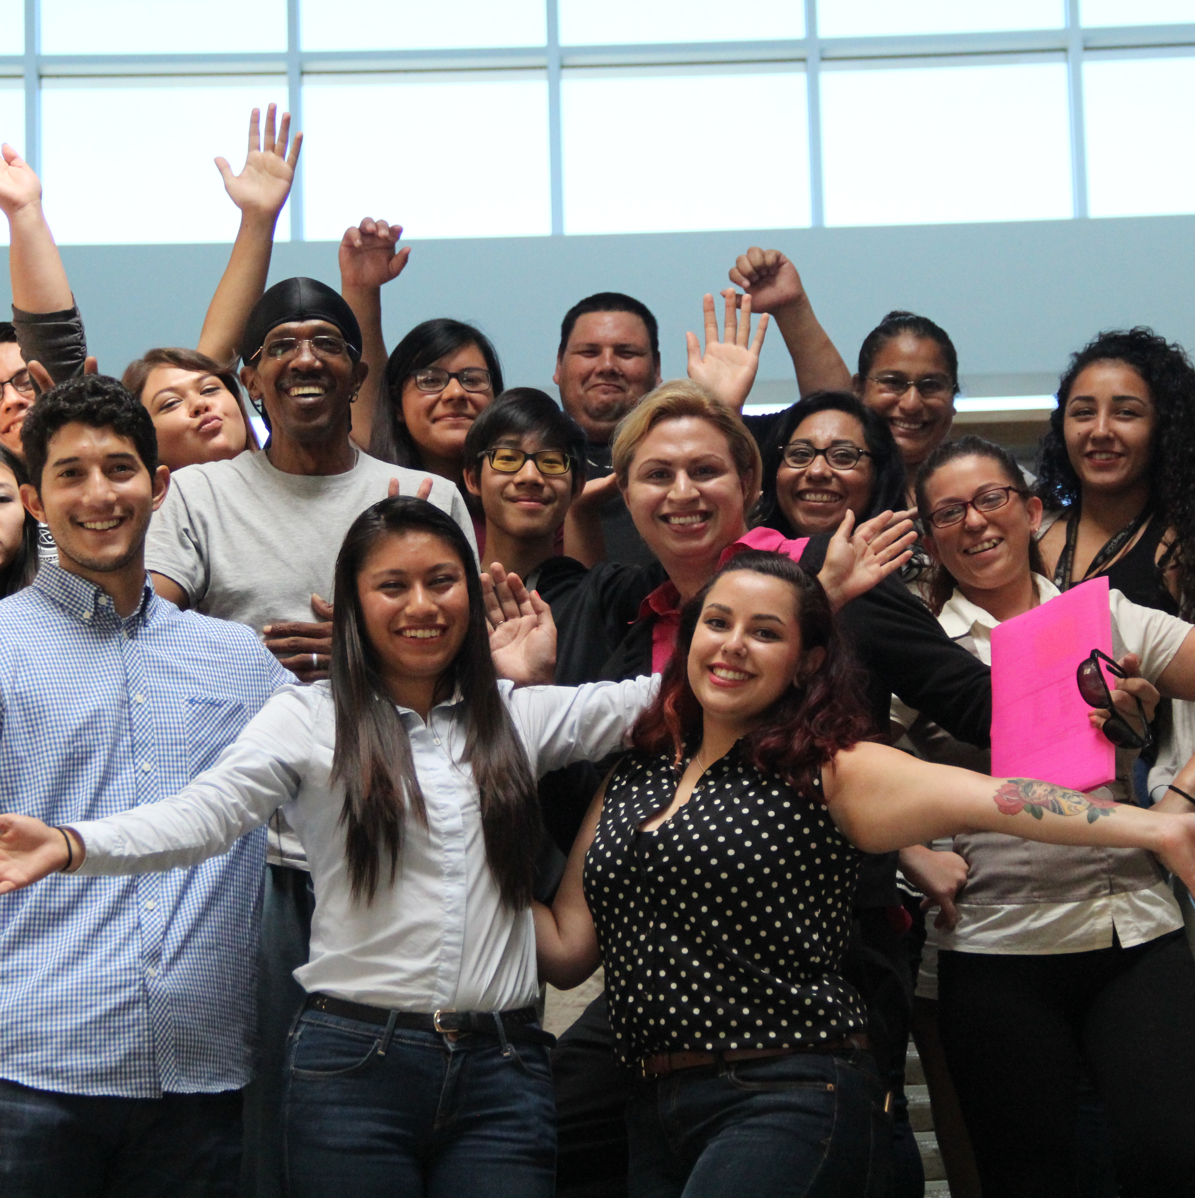

Thank you!
Please email additional questions to perkinssupport@cccco.edu
www.cccco.edu

